Slide 1
Performance Evaluation of DNN Embedding-based Speaker Identification System
Paper ID-360849
Presented by:
Pranav Madanu
Department of Electronics and Communication Engineering Koneru Lakshmaiah Education Foundation, Hyderabad, India
Co-authors - Rohan Madanu, Pranav Madanu, A.B Nitin, Rizwan ,MD Sameer Ahmed
2nd International Conference on Performance Evaluation of DNN Embedding–based Speaker Identification System, CCPIS 2025

Slide 2

Contents
Introduction
Related Work
Proposed Methodology
Dataset Description
Software Packages
Results and Discussion
Conclusion
References
2nd International Conference on Performance Evaluation of DNN Embedding–based Speaker Identification System

Slide 3
Introduction
Speaker identification aims to authenticate individuals based on vocal characteristics (physio-behavioral traits like vocal tract shape and accent).
The Shift: Traditional methods used Gaussian Mixture Models (GMM-UBM). This study moves toward Deep Neural Networks (DNN) for better feature extraction.
Objective: To evaluate a DNN embedding model using Probabilistic Linear Discriminant Analysis (PLDA) scores on a custom 51-speaker dataset
Key Metrics: Performance is assessed using Equal Error Rate (EER) and Accuracy.[3-4]
2nd International Conference on Performance Evaluation of DNN Embedding–based Speaker Identification System

Slide 4
Related Work
[1]] Google’s Voice Match system employs deep neural embeddings to personalize device responses and authenticate users across multilingual environments.
[2] Amazon Alexa’s speaker recognition uses DNN-based voice profiles to distinguish household members for secure and personalized interactions.
[3] GMM-UBM and i-vector methods provided early compact speaker representations but were highly sensitive to noise and channel mismatch.
[4] DNN-based x-vector and d-vector architectures improved robustness by learning discriminative embeddings for speaker identification.
2nd International Conference on Performance Evaluation of DNN Embedding–based Speaker Identification System

Slide 5
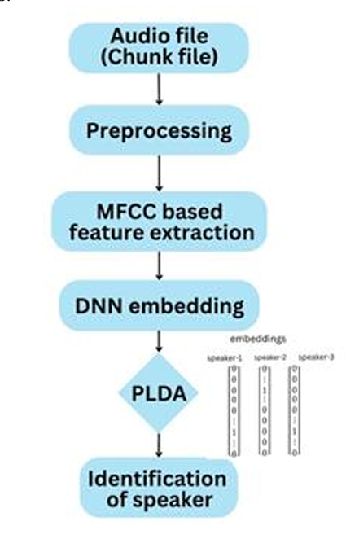
Proposed Methodology
The system processes raw speech through a five-stage pipeline. First, audio chunks are acquired and preprocessed to reduce noise and enhance quality.
MFCC features are then extracted to represent key spectral–temporal cues. These are fed into a DNN embedding network to generate discriminative speaker vectors.
Finally, a PLDA backend computes similarity scores for identifying the target speaker.
2nd International Conference on Performance Evaluation of DNN Embedding–based Speaker Identification System

Slide 6
DNN embedding
The DNN processes MFCC feature sequences using time-delay layers that capture temporal dependencies and learn speaker-specific patterns.
A statistics-pooling layer computes the mean and variance across all frames, converting variable-length audio into a fixed-length representation.
Segment-level layers refine these representations into high-dimensional speaker embeddings, which encode discriminative vocal traits for PLDA scoring.
2nd International Conference on Performance Evaluation of DNN Embedding–based Speaker Identification System

Slide 7
Dataset Description
Table 1: Description of Speech Corpus
S.No. | Particulars | Features
1 | Total number of speakers | 51
2 | Areas of speakers | UG students, Doctors, Actors, Politicians, Professors.
3 | Native places of speaker | All over India
4 | Gender | Male and female
5 | Frequency & Channel | 16 KHz, Mono
6 | Ages of speakers | 17-60 years
7 | Speaking Language | Indian Accent English, Hindi, Telugu
9 | Duration of Each Speaker | 15-20 Seconds
10 | Number of utterances of each speaker | 20 per language
2nd International Conference on Performance Evaluation of DNN Embedding–based Speaker Identification System

Slide 8
Software packages
Technical Details
Table 2: Required Tools and libraries to implement Speaker Identification
Required Packages | Description
Google Colab: | A cloud-based Jupyter notebook service that provides free access to GPU and TPU hardware for machine learning experiments.
TensorFlow / Keras | Deep learning frameworks used to design, train, and evaluate the speaker identification model.
Librosa | A Python library for audio and music analysis, used to extract MFCC (Mel-Frequency Cepstral Coefficients) and other acoustic features from the input voice samples.
NumPy and Pandas | Libraries used for numerical computation and efficient handling of large datasets.
Matplotlib | Used for visualizing accuracy, loss, and feature distribution during model training and testing.
scikit-learn | Used for label encoding, data splitting, and evaluation metrics computation.
Google Drive Integration | Used for dataset storage, model checkpoints, and saving final trained models.
2nd International Conference on Performance Evaluation of DNN Embedding–based Speaker Identification System

Slide 9
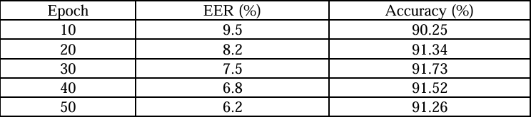
Results – Accuracy & EER
Performance improved steadily as training epochs increased from 10 to 50, with the best results achieved at 50 epochs—reducing the EER to 6.2% and increasing accuracy to 91.26%.
2nd International Conference on Performance Evaluation of DNN Embedding–based Speaker Identification System

Slide 10
Table 4: Accuracy and Loss with the variation of epochs
Epoch | Training Accuracy | Validation Accuracy | Training Loss | Validation Loss
10 | 0.8946 | 0.9104 | 0.3115 | 0.2135
20 | 0.9090 | 0.9178 | 0.2868 | 0.2019
30 | 0.9149 | 0.9156 | 0.2761 | 0.1915
40 | 0.9090 | 0.9178 | 0.2868 | 0.2019
50 | 0.9129 | 0.9123 | 0.2604 | 0.2177
2nd International Conference on Performance Evaluation of DNN Embedding–based Speaker Identification System

Slide 11
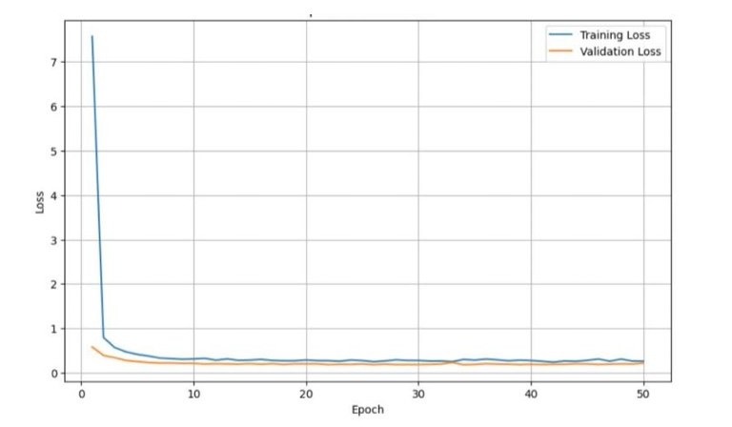
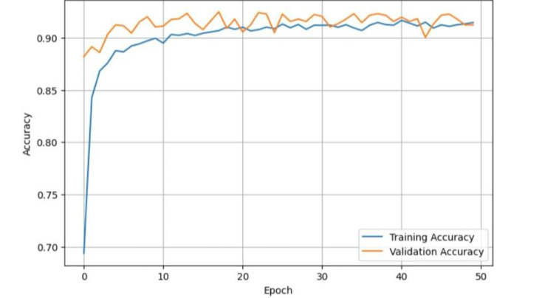
Results and discussion
Figure 1: Shows validation accuracy slightly surpassing training accuracy, indicating no overfitting and good generalization.
Figure 2 : Both training and validation loss decrease and converge smoothly by epoch 50, showing stable optimization.
Table 2: Epochs vs Model Loss
Table 1: Epochs vs Accuracy
2nd International Conference on Performance Evaluation of DNN Embedding–based Speaker Identification System

Slide 12
Conclusion
Developed a robust DNN-PLDA speaker identification system using a diverse in-house dataset of 51 speakers.
Achieved stable convergence with 91.26% accuracy and a 6.2% Equal Error Rate.
Demonstrated strong generalization capability, with validation accuracy consistently higher than training accuracy.
Future work includes expanding the dataset, evaluating performance in noisier environments, and exploring Transformer-based architectures.
Training and validation curves showed consistent improvement and stable convergence, with validation metrics outperforming training, indicating efficient learning and absence of overfitting.
2nd International Conference on Performance Evaluation of DNN Embedding–based Speaker Identification System

Slide 13
References
1) Hanifa, Rafizah Mohd, Khalid Isa, and Shamsul Mohamad. "A review on speaker recognition: Technology and challenges." Computers & Electrical Engineering 90 (2021): 107005.
2) Faundez-Zanuy, Marcos, and Enric Monte-Moreno. "State-of-the-art in speaker recognition." IEEE Aerospace and Electronic Systems Magazine 20, no. 5 (2005): 7-12.
3) Tahon, Marie, and Laurence Devillers. "Towards a small set of robust acoustic features for emotion recognition: challenges." IEEE/ACM transactions on audio, speech, and lan guage processing 24, no. 1 (2015): 16-28.
4) Li, Ming, Kyu J. Han, and Shrikanth Narayanan. "Automatic speaker age and gender recognition using acoustic and prosodic level information fusion." Computer Speech & Language 27, no. 1.
5) Wang, Qiongqiong, Koji Okabe, Kong Aik Lee, and Takafumi Koshinaka. "Generalized domain adaptation framework for parametric back-end in speaker recognition." IEEE Transactions on Information Forensics and Security 18 (2023): 3936-3947.
6) Prabakaran, Durairaj, and S. Sriuppili. "Speech processing: MFCC based feature extraction techniques-an investigation." In Journal of Physics: Conference Series, vol. 1717, no. 1, p. 012009. IOP Publishing, 2021.
2nd International Conference on Performance Evaluation of DNN Embedding–based Speaker Identification System

Slide 14
Thank You!
2nd International Conference on Performance Evaluation of DNN Embedding–based Speaker Identification System

